Slide 1
TREES

Slide 2
Linear vs non- linear data structure
Linear data structures
  Linear data structures organize their data elements in a linear fashion, where data elements are attached one after the other.
  Data elements in a liner data structure are traversed one after the other and only one element can be directly reached while traversing.
  Linear data structures are very easy to implement, since the memory of the computer is also organized in a linear fashion.
  Examples: Arrays, linked lists, stacks and queues.
Nonlinear data structures
  Nonlinear data structures, data elements are not organized in a sequential fashion.
  A data item in a nonlinear data structure could be attached to several other data elements to reflect a special relationship among them and all the data items cannot be traversed in a single run.
  Examples: multidimensional arrays, multi-linked lists, trees and graphs

Slide 3
Trees
A tree is a nonlinear data structure used to represent entities that are in some hierarchical relationship
Examples in real life:
  Family tree
  Table of contents of a book
  Computer file system (folders and subfolders)
  Decision trees

Slide 4
Example: Computer File System
Root directory of C drive
Documents and Settings
Program Files
My Music
Desktop
Favorites
Start Menu
Adobe
Microsoft Office

Slide 5
Tree Definition
Tree: a set of elements of the same type such that
  It is empty
  Or,
  it has a distinguished element called the root from which descend zero or more trees (subtrees)
Notes:
Recursive!

Slide 6
More Tree Terminology
Degree of a node: the number of children it has
Degree of a tree: the maximum of its node degrees.

Slide 7
Binary Trees
A tree each of whose nodes may have no more than 2 children
  i.e. a binary tree is a tree with degree 2
  The children (if present) are called the left child and right child
Recursive definition of a binary tree:
it is
  The empty tree
  Or, a tree which has a root whose left and right subtrees are binary trees

Slide 8
Binary Tree
A
B
C
D
E
F
G
H
I

Slide 9
Maximum Number of Nodes in BT
The maximum number of nodes on level i of a binary tree is 2^{i-1}, i>=1. (taking root node at level 1)
When n=0 the root node will be placed at 0th location
      Parent(n)=floor(n-1)/2
      Left(n)=(2n+1)
      Right(n)=(2n+2)

Slide 10
Other Kinds of Binary Trees
(Full Binary Trees)
Full Binary Tree: A full binary tree is a binary tree where all the leaves are on the same level and every non-leaf has two children
The first four full binary trees are:
CS 103

Slide 11
Examples of Non-Full Binary Trees
These trees are NOT full binary trees?
CS 103

Slide 12
Canonical Labeling of
Full Binary Trees
Label the nodes from 1 to n from the top to the bottom, left to right
1
1
1
3
2
2
3
4
5
6
7
1
2
3
Relationships between labels
of children and parent:
5
6
7
4
i
8
9
10
11
13
14
15
2i
2i+1
12
CS 103

Slide 13
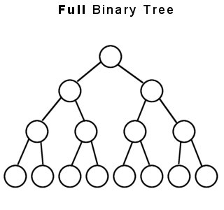
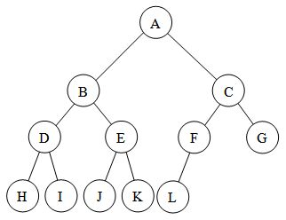
Full v.s. Complete Binary Trees
A full binary tree (sometimes proper binary tree or 2-tree) is a tree in which every node other than the leaves has two children
A complete binary tree is a binary tree in which every level, except possibly the last, is completely filled, and all nodes are as far left as possible.

Slide 14
Other Kinds of Binary Trees
(Almost Complete Binary trees)
Almost Complete Binary Tree: An almost complete binary tree of n nodes, for any arbitrary nonnegative integer n, is the binary tree made up of the first n nodes of a canonically labeled full binary
1
1
1
1
1
2
3
2
2
3
2
1
1
4
5
6
4
2
3
2
3
4
5
4
5
6
7
CS 103

Slide 15
Implementing trees
Using Array
Using Linked List

Slide 16
Implementing Trees with Arrays
For certain types of trees, specifically binary trees, a computational strategy can be used for storing a tree using an array
For any element stored in position n of the array, that elements left child will be stored in position ((2*n) + 1) and that elements right child will be stored in position (2*(n+1))
1-<number>
Notes:
For certain types of trees, specifically binary trees, a computational strategy can be used for storing a tree using an array. For any element stored in position n of the array, that elements left child will be stored in position (2*n) and that elements right child will be stored in position (2*n+1). This strategy is very effective and can be managed in terms of capacity in much the same way that we managed capacity for the array implementations of lists, queues, and stacks. However, despite the conceptual elegance of this solution, it is not without drawbacks. For example, if the tree that we are storing is not complete or relatively complete, we may be wasting large amounts of memory allocated in the array for positions of the tree that do not contain data.

Slide 17
Implementing Trees with Arrays
This strategy can be managed in terms of capacity in much the same way that we did for other array-based collections
Despite the conceptual elegance of this solution, it is not without drawbacks
For example, if the tree that we are storing is not complete or relatively complete, we may be wasting large amounts of memory allocated in the array for positions of the tree that do not contain data
1-<number>
Notes:
For certain types of trees, specifically binary trees, a computational strategy can be used for storing a tree using an array. For any element stored in position n of the array, that elements left child will be stored in position (2*n) and that elements right child will be stored in position (2*n+1). This strategy is very effective and can be managed in terms of capacity in much the same way that we managed capacity for the array implementations of lists, queues, and stacks. However, despite the conceptual elegance of this solution, it is not without drawbacks. For example, if the tree that we are storing is not complete or relatively complete, we may be wasting large amounts of memory allocated in the array for positions of the tree that do not contain data.

Slide 18
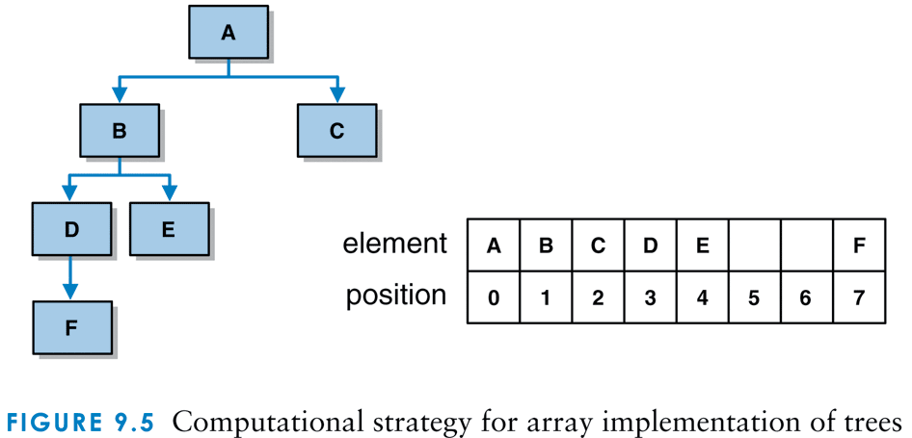
Computational strategy for array implementation of trees
1-<number>

Slide 19
typedef struct node
{
struct node*left;
struct node*right;
char data;
}node;
void main()
{
node*tree=NULL;
char c[] = {'A','B','C','D','E','F','\0','G','\0','\0','\0','\0','\0','\0','\0','\0','\0','\0','\0','\0','\0'};
tree=insert(c,0);
inorder(tree); }

Slide 20
node* insert(char c[],int n)
{ node*tree=NULL;
if(c[n]!='\0')
{
tree=(node*)malloc(sizeof(node));
tree->left=insert(c,2*n+1);
tree->data=c[n];
tree->right=insert(c,2*n+2);
}
return tree; }

Slide 21
Advantages of Sequential Representation
The only advantage is direct access to any node can be possible.
Finding parent, left or right child of any particular node is fast

Slide 22
Disadvantages of Sequential Representation
The major disadvantage with this type of representation is wastage of memory.
  For Example: Left skewed tree half or right skewed tree half.
Maximum depth of tree needs to be fixed because the array size is fixed.
  If array size quite larger than depth of tree it will be a wastage of memory.
  If not we will be unable to store some part of tree

Slide 23
Linked Representation
typedef struct node {
int data;
struct node *left,
struct node *right;
};
data
left_child
data
right_child
left_child
right_child

Slide 24
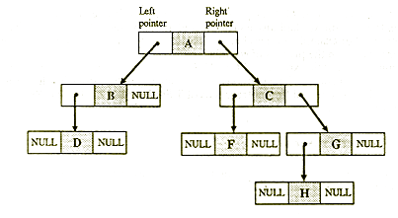
Linked List Representation of binary tree
The left child is the left link which points to some address of left sub-tree and right child is a right link that points to some address of right sub-tree.

Slide 25
Advantages of Linked representation
No wastage of memory.
No need of prior knowledge of depth of tree.
Insertion and deletions can be done easily without moving other nodes.

Slide 26
Disadvantages
The representation does not provide direct access to a node and special algorithms.
Representation needs additional space in each node for storing the left and right sub-trees.

Slide 27
Operations on Binary tree
Creation of binary tree
Insertion of a node
Display

Slide 28
Creation and Insertion
Do
{
New =getnode(); //use malloc function to create a node
Printf(“enter the data”)
Scanf(“%d”,&new->data)
If(root==NULL)
Root=New
Else
insert(root,new);
Printf(“do you wanna continue(Y/N);
ans=getch()
}while(ans=‘y’||ans=‘Y’)

Slide 29
Void insert(node *root, node *new)
{
int ch;
printf(“where to insert left/right %d”, root->data);
Ch=getch();
If((ch=‘r’)||(ch=‘R’))
{
if(root->right==NULL)
root->right=New;
else
insert(root->right, New);
}
Else
{
if(root->left==NULL)
{ root->left=New; }
else
insert(root->left, New);}

Slide 30
Tree Traversals

Slide 31
Tree Traversals
A traversal of a tree requires that each node of the tree be visited once
  Example: a typical reason to traverse a tree is to display the data stored at each node of the tree
Standard traversal orderings:
  preorder
  inorder
  postorder
  level-order

Slide 32
Traversals
A
B
C
D
E
F
G
H
I
We’ll trace the different traversals using this tree; recursive calls, returns, and “visits” will be numbered in the order they occur

Slide 33
Preorder Traversal
Start at the root
Visit each node, followed by its children; we will choose to visit left child before right
Recursive algorithm for preorder traversal:
  If tree is not empty,
    Visit root node of tree
    Perform preorder traversal of its left subtree
    Perform preorder traversal of its right subtree

Slide 34
Preorder Traversal
1: visit A
2
24
23
45
3: visit B
25: visit C
4
16
26
38
15
22
37
44
39: visit G
5: visit D
17: visit E
27: visit F
.
.
.
.
.
6
8
18
28
21
40
19
34
36
41
43
7
14
20
35
42
9: visit H
29: visit I
.
.
.
.
30
33
10
13
11
12
31
32
Nodes are visited in the order ABDHECFIG

Slide 35
Exercise- Print nodes using Preorder traversal
Assume: visiting a node
is printing its label
1
3
7
5
8
9
10
4
6
11
12

Slide 36
Solution
Assume: visiting a node
is printing its label
Preorder:
1 3 5 4 6 7 8 9 10 11 12
1
3
7
5
8
9
10
4
6
11
12

Slide 37
Inorder Traversal
Start at the root
Visit the left child of each node, then the node, then any remaining nodes
Recursive algorithm for inorder traversal
  If tree is not empty,
    Perform inorder traversal of left subtree of root
    Visit root node of tree
    Perform inorder traversal of its right subtree

Slide 38
Inorder Traversal
23: visit A
1
24
22
45
14: visit B
37: visit C
2
15
25
38
13
21
36
44
41:
visit G
5: visit D
18: visit E
33: visit F
.
.
.
.
.
3
6
16
26
20
39
17
32
35
40
43
4
12
19
34
42
9: visit H
29: visit I
.
.
.
.
27
31
7
11
8
28
10
30
Nodes are visited in the order DHBEAIFCG

Slide 39
Exercise- Print nodes using InorderTraversal
Assume: visiting a node
is printing its label
1
3
7
5
8
9
10
4
6
11
12

Slide 40
Solution
Assume: visiting a node
is printing its label
Inorder:
4 5 6 3 1 8 7 9 11 10 12
1
3
7
5
8
9
10
4
6
11
12

Slide 41
Postorder Traversal
Start at the root
Visit the children of each node, then the node
Recursive algorithm for postorder traversal
  If tree is not empty,
    Perform postorder traversal of left subtree of root
    Perform postorder traversal of right subtree of root
    Visit root node of tree

Slide 42
Postorder Traversal
45: visit A
1
23
22
44
21: visit B
43: visit C
2
14
24
36
13
20
35
42
41:
visit G
12: visit D
19: visit E
34: visit F
.
.
.
.
.
3
5
15
25
18
37
16
31
33
38
40
4
11
17
32
39
10: visit H
30: visit I
.
.
.
.
26
29
6
9
7
8
27
28
Nodes are visited in the order HDEBIFGCA

Slide 43
Exercise- Print nodes using PostOrder Traversal
Assume: visiting a node
is printing its label
1
3
7
5
8
9
10
4
6
11
12

Slide 44
Solution
Assume: visiting a node
is printing its label
Postorder:
4 6 5 3 8 11 12 10 9 7 1
1
3
7
5
8
9
10
4
6
11
12

Slide 45
Discussion
Note that the relative order of the recursive calls in preorder, inorder and postorder traversals is the same
The only differences stem from where the visiting of the root node of a subtree actually takes place

Slide 46
Discussion
In Preorder, the root
is visited before (pre)
the subtrees traversals
In Inorder, the root is
visited in-between left
and right subtree traversal
In Preorder, the root
is visited after (pre)
the subtrees traversals
Preorder Traversal:
Visit the root
Traverse left subtree
Traverse right subtree
Inorder Traversal:
Traverse left subtree
Visit the root
Traverse right subtree
Postorder Traversal:
Traverse left subtree
Traverse right subtree
Visit the root

Slide 47
Illustrations for Traversals (Contd.)
Assume: visiting a node
is printing its data
15
8
20
2
11
27
6
10
12
22
30
3
7
14

Slide 48
Illustrations for Traversals (Contd.)
Assume: visiting a node
is printing its data
Preorder: 15 8 2 6 3 7
11 10 12 14 20 27 22 30
Inorder: 2 3 6 7 8 10 11
12 14 15 20 22 27 30
Postorder: 3 7 6 2 10 14
12 11 8 22 30 27 20 15
15
8
20
2
11
27
6
10
12
22
30
3
7
14

Slide 49
Arithmetic Expression Using BT
+
inorder traversal
A / B * C * D + E
infix expression
preorder traversal
+ * * / A B C D E
prefix expression
postorder traversal
A B / C * D * E +
postfix expression
level order traversal
+ * E * D / C A B
*
E
*
D
/
C
A
B

Slide 50
Inorder Traversal (recursive version)
void inorder(tree_pointer ptr)
/* inorder tree traversal */
{
if (ptr) {
inorder(ptr->left_child);
printf(“%d”, ptr->data);
inorder(ptr->right_child);
}
}
A / B * C * D + E

Slide 51
Preorder Traversal (recursive version)
void preorder(tree_pointer ptr)
/* preorder tree traversal */
{
if (ptr) {
printf(“%d”, ptr->data);
preorder(ptr->left_child);
predorder(ptr->right_child);
}
}
+ * * / A B C D E

Slide 52
Postorder Traversal (recursive version)
void postorder(tree_pointer ptr)
/* postorder tree traversal */
{
if (ptr) {
postorder(ptr->left_child);
postdorder(ptr->right_child);
printf(“%d”, ptr->data);
}
}
A B / C * D * E +

Slide 53
Level Order Traversal
Start at the root
Visit the nodes at each level, from left to right

Slide 54
Level Order Traversal
A
B
C
D
E
F
G
H
I
Nodes will be visited in the order ABCDEFGHI

Slide 55
Level Order Traversal
(using queue)
void level_order(tree_pointer ptr)
/* level order tree traversal */
{
int front = rear = 0;
tree_pointer queue[MAX_QUEUE_SIZE];
if (!ptr) return; /* empty queue */
addq(front, &rear, ptr);//insert ptr in queue
for (;;) {
ptr = deleteq(&front, rear);//delete from queue.

Slide 56
if (ptr) {
printf(“%d”, ptr->data);
if (ptr->left_child)
addq(front, &rear,
ptr->left_child);
if (ptr->right_child)
addq(front, &rear,
ptr->right_child);
}
else break;//if queue is empty, exit
}
}

Slide 57
END

